Slide 1
Introduction to User Stories and User Story Mapping
BookingGo Agile Coaches
Notes:
Hello and welcome

Slide 2
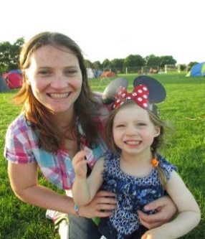

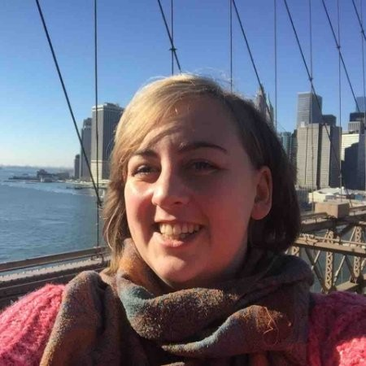
Meet the Agile Team!
Meet the team helping you today
Caz
Mat
Elly
2
Notes:
House keeping
Agenda:
Day 1
User story mapping
Solution v need
Value
Users
Goals
Who should do this
When it should be done
How does this relate to Agile principles
Breaks:
-
Rules:
- No laptops or phones unless note taking

Slide 3
Agenda
User story mapping
Solution vs need
Value
Users
Goals
Who should do this?
When it should be done?
How does this relate to Agile?

Slide 4
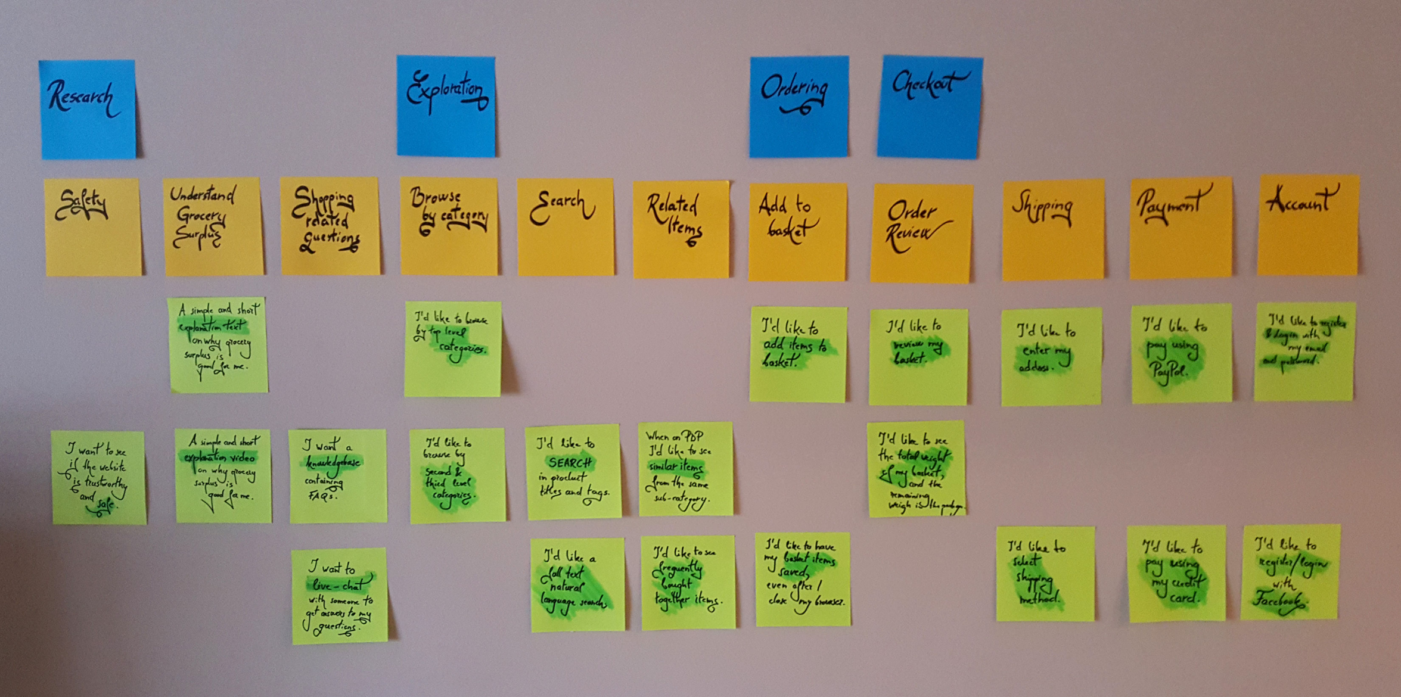
User Story Mapping
Notes:
What is story mapping?
Story mapping is a technique that helps us to scope out a piece of work.
Before we start a piece of work we need to:
- get an idea of how much is involved
- work out what our top priority work is.
A story map is a very simple way to be able to get an idea of this at a glance
What
A method to help us scope the work.
Creates our backlog.
Discovery tool to help us capture high level needs and get an idea of what's involved in the piece of work.
Why?
Visual representation of the product backlog, scope, size, complexity for the team and all stakeholders to see.
Builds shared understanding as it built collaboratively
Helps us differentiate important features from nice to haves so helps us work out our MVP
Can help with relative sizing
Gives us a high level place to start and allows us to enhance our picture later.
When should we Story Map?
At the start of a new feature – could be something fairly small or could be a large piece of work. We can use the story mapping prioritise the most important features so this should be done a little bit ahead of the work.
Depending on your organisation this might be done prior to the piece of work getting the feature OK'ed to start OR might be done just before the work is started (if your organisation does not require approval to start work)
How We identify our users and what they're trying to achieve. Then we think about what value the user is going to get from achieving the goal. This gives us a basic story map which we can revise and refine, add detail to later. We'll delve further into this shortly
Conclusion
Story mapping is a good tool to help us create a product backlog which visually represents our product/feature.
Helps building a shared understanding, helps identify dependencies, gaps and relatively size our backlog.

Slide 5

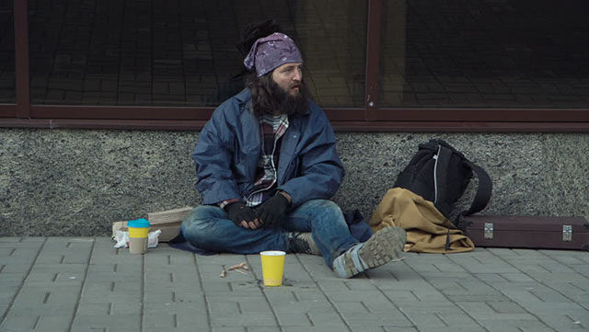

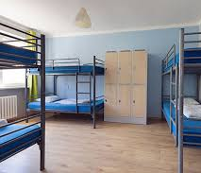
Notes:
Users
Outcome
- can describe the users of a product
- can describe why it is important to focus on them
Connect
In fours -
Take a look at Facebook.
List features you have noticed but you don't use.
Why don't you use this?
Who do you think this was built for?
What is the impact on you? E.g. irritation, use platform less.
What is the impact of that on Facebook e.g. lost revenue – people leave. Wasted time
Facebook caters for a wide user base – what appeals to me doesn't necessarily appeal to you – each user has different wants and needs of the system. However, in order to make sure that we cater properly for each user we need to understand who they are and what they want. Let's start with who they are.
Concept
Personas give us a glimpse into one of our user's perspectives. We need to be mindful that each user group is made up of multiple personas. So a user group of "commuter" contains both Cathy with five kids doing four jobs and Jim who has one job and is very highly paid with no dependents. We need to keep to user groups for this stage but bear in mind that we are catering broadly – for both Cathy and Jim's needs.
Concrete
Here are some new personas for the same scenario as earlier
1) Jack = a rough sleeper. Jack sleeps on the street of Manchester. As a result of not having a shelter to go to, he is susceptible to bad weather, ill health and his belongings aren't secure.
2) Cath = a commuter. works in Manchester. On her commute to and from work she walks past Jack every day. She feels very worried about Jack and wants to help him. However, she rarely carries cash these days so she can't often give him money.
3) Steve = Hostel worker. Steve works on the desk in a hostel. People come to the hostel for a bed and access to the facilities for which the hostel charge £15 per night.
4) Sophie = Hostel owner. Sophie owns the hostel. She has utility bills to pay including wages for Steve (and the other hostel workers). If the hostel bills do not get paid the hostel will close down and the staff will leave
5) Becky = Bank Manager. Becky is the manager of the bank that Cath uses. Becky must ensure the bank makes money for its shareholders
What do they want from this interaction?
e.g.
1) Jack = bed for the night, safety
2) Cath = peace of mind
3) Steve = do his job to best of his ability, get paid
4. Sophie = fulfill their purpose of providing homes for homeless and making enough money to keep the hostel open
5) Becky = ensure that Cath is a happy customer and stays with this bank. Transaction fee / stickiness = by facilitating Cath's transactions they get to keep her money in their accounts and make money from this investment
Conclusion
Already we can see a journey forming in our minds. Knowing this helps us build actions
We are going to put these people down the side of our map. In our story map we talk about users rather than personas. The idea behind this is that we are customer focused – we're creating something to help our user meet their goal.

Slide 6

NEED
SOLUTION
Notes:
Solution versus need
Outcome
Can describe and identify a solution versus a need/goal
Concept/goal
When scoping something ideally you start with a problem statement – the need. You do not jump directly to a solution.
What is a need?
A need is something that is necessary for human beings to live a healthy life.
e.g. I need a source of nutrients in order to stay alive. This is a physiological need.
MASLOW Here – intro Maslow’s hierarchy and explain his theory that the needs start at the bottom of the pyramid and people tend to focus on the upper layers once the lower layers are in place.
What is a solution?
A solution is a way to address a need. There can be multiple ways to address one need.
e.g. I eat a hamburger. Another might be to drink a protein shake. If I'm in a coma I might be given nutrients via a feeding tube.
These are all solutions to me needing nutrients.
Concrete
In your groups let's get creative.
Jack needs money so he can get a bed in a hostel tonight.
How can we make this happen? List out all the ways.
What if the problem is actually
Jack needs somewhere safe and dry to sleep.
How can we make this happen? List out all the ways?
What did you notice about your lists for each exercise? Which list did you enjoy creating? Which generated more ideas?
Conclusion
The first exercise gave you a solution – this constrained your thinking. The second gave you a broader problem to look at which gave an opportunity to think creatively and generated more ideas.
This is why we want you to focus on need in the sessions over the next two days.
Solution closes down conversations. Can take us into a lot of detail very quickly when it might be possible to reach the objective faster.
Need focuses on the customer and stops discussion on topics that may not add value

Slide 7

Notes:
Outcome
Can list actions in process without solutionising
Connect
We are still at the needs stage. As we have not decided what work we are going to proceed with we don't want to go into detail on anything too soon – if we flesh something out and don't use it all our effort goes to waste.
Concept
Now we have user let's map out their journey
We need to add the goals that will make up the transaction
(We need to make sure we still do not form solutions at this stage)
Concrete
Write out the process from the perspective of each user. Write each step in the process on a different post it note. We will come back to this shortly.
Conclusion
Important to stay at the need level still. NOT the solution level.

Slide 8
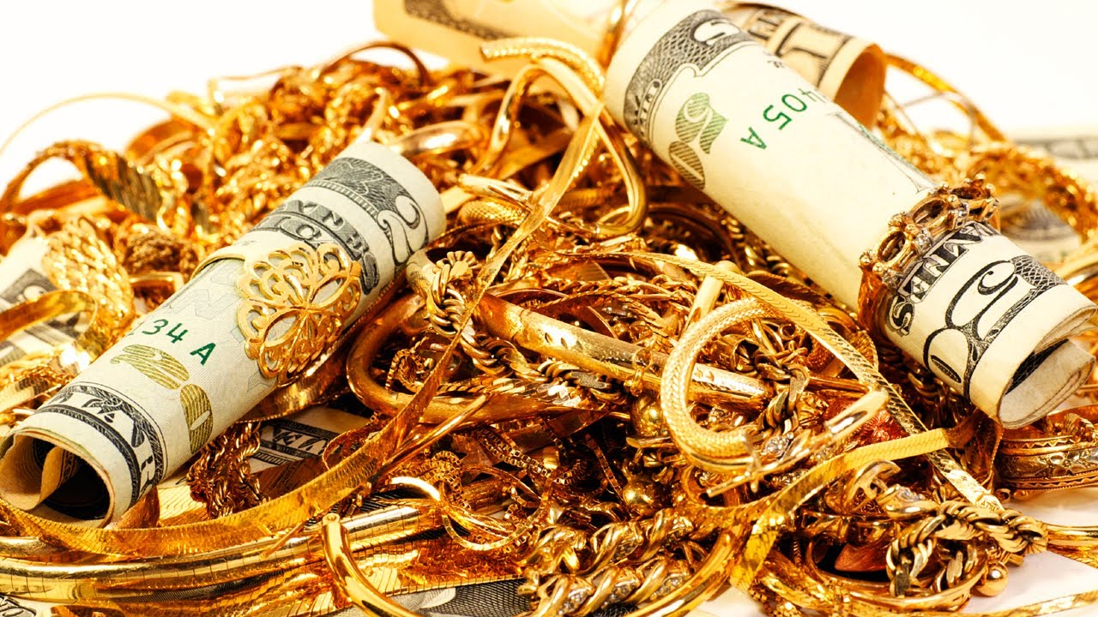
Notes:
What is value?
Outcome
- Can list different types of value.
- Can identify value in a journey
Value is something that is "worth" something to someone. Different people value different things in different circumstances and this has an impact on human behaviour – in the product world this often means that people will pay for something they value. Your businesses value your skills, potential and contribution to their work so they pay you for it.
Different people value different things – value is something that’s very subjective and circumstance dependent.

Slide 9
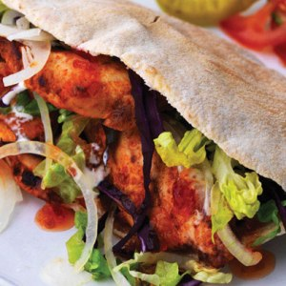
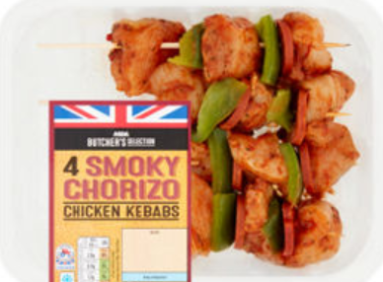
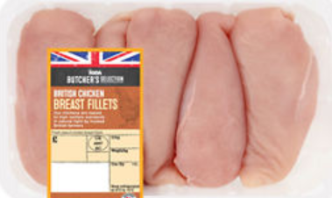
CHICKEN KEBAB FOR TEA
TAKE AWAY
PREPPED
MAKE FROM SCRATCH
Prep time: 3 mins
Cost: £6.40 plus delivery
Calories: 589
Prep time: 20 mins plus shopping time
Cost: £3.10
Calories: 340
Prep time: 30 mins plus shopping time
Cost: £1.50
Calories: 310
Notes:
Looking at each persona which of our options might appeal to each person most and why?
Carl, 29.
Solicitor.
Visiting Dad in hospital this evening 7-8.
Needs to finish preparing for tomorrow's court case once he gets home.
Felicity, 36.
Personal trainer.
Has a client until 7 this evening but then has plans with the TV.
Steve, 40.
Just been made redundant.
Has Slimming World weigh in at 5.30 today but no other plans.
Each of our different personas are likely to find appeal in a different option. Steve is dieting AND has been made redundant – he is likely to value the cheaper and lower calorie options than the take away option whereas Carl is more likely to opt for the take away as he values his time at the moment. However, you might have come up with different options because YOU saw value in something different in these scenarios.

Slide 10
Notes:
Connect
List types of value
e.g.
Knowledge
Money
Security
Good health
Not losing money
Good karma
Peace of mind
Time
Having a full stomach
Customer loyalty
Concept
Value means different things to different people. One way to look at this is to look at the transactions between our users.
A transaction delivers value to both parties
For example, Person A gets money. Person B feels good about themselves
Concrete
Now let's add the value into our chart.
Conclusion
If we focus on where the value is we can zoom in on what we should work on and not waste time creating features that won't be used as much
- draw out Value S curve
80 – 20 rule
First we need to identify who is involved in each transaction
Stick an empty post-it in the grid if a person is involved in an action
Next we add in the value – let’s write this on the post-it notes
e.g. Caz + gives money....Value = good karma

Slide 11
User Story Maps map
Focus on the
Person
Value
Goal
Removes excess detail
Visual map of scope
how big?
how complex?
Helps us prioritise
Notes:
Summarise what a user story map does
Q: When should we do this?
A: Up front (but high level – remember our Facebook features
For new pieces of work
Q: Who should be a part of this?
A: EVERYONE NEEDS TO BE INVOLVED
The answer to these questions is solved by Agile principles.......

Slide 12
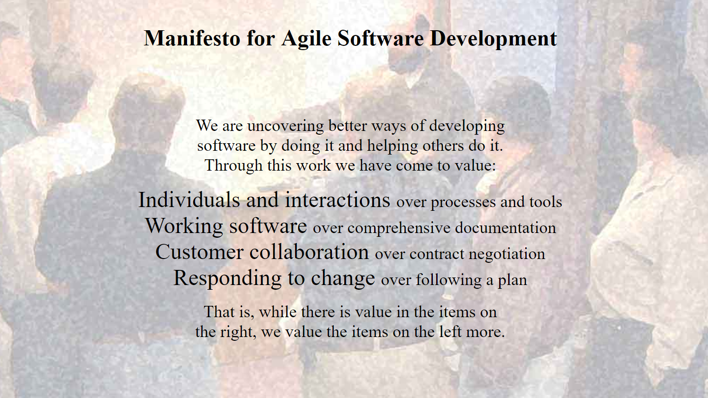
Notes:
When
1) Working software = focusing on the goal without the limitation of a tech stack means we can deliver value faster without diving down rabbit hole that limit our ability to meet our goal.
2) Responding to change = need NOT solution and subsequently keeping stories independent from each other means we can pivot even in a late stage of development
Who
1) Individual interactions = collaborate with each other. A user story is a record of a conversation. If you develop this together you will understand each other better
2) Customer collaboration = customer focus. Non-technical way to bring them into the conversation.

Slide 13


Slide 14
Agenda
Creating a backlog using user stories
Acceptance Criteria
INVEST
Relative sizing

Slide 15
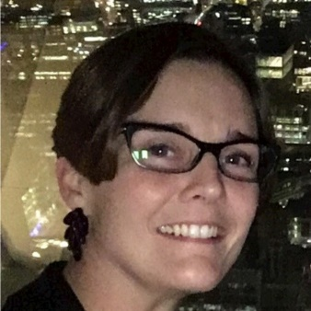
Meet the Agile Team!
Meet the team helping you today
Caz
Mat
Elly
Susannah
15
Notes:
House keeping
Laptops and phones
Day 2
Creating a backlog using user stories
Estimating return on investment
Breaking down areas of work
How to write a good story
Relative sizing
Prioritisation
Breaks:
-

Slide 16

Recap Story Mapping
Value
Users
Goals
Notes:
Let's remind ourselves what we did yesterday:
Who can tell us the three components we identified for our story map.
Users
Goals
Value
What are some of the different types of value?
Why is it important to identify

Slide 17
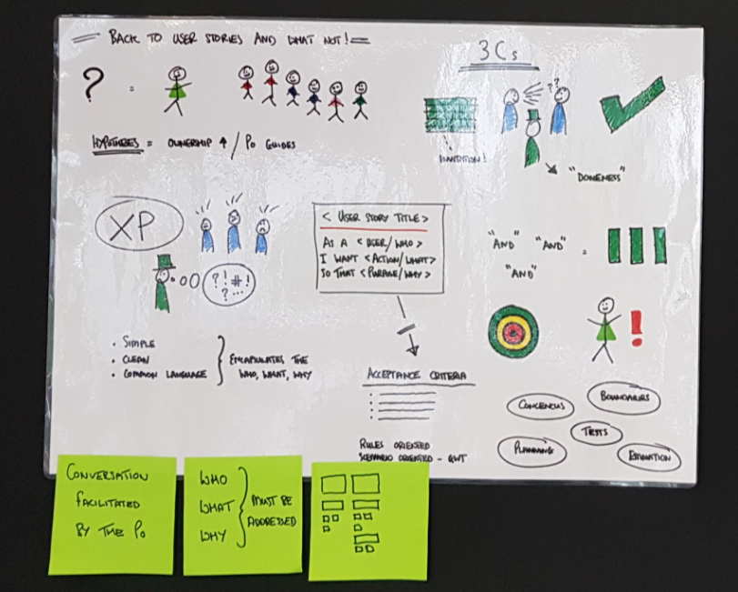
Origins of User Stories
Notes:
Origins of User Stories
Came from Extreme Programming.
Designed by developers to allow for non technical discussion.
Originally 3Cs
Card
Conversation
Confirmation
Epics – big stories. WHAT, WHO & WHY.
User stories – small enough to understand, estimate, implement. WHAT, WHO & WHY
Tasks - HOW
Lots of teams fall into the trap of working at solely at task level and 1. Lost the ability to delivery value with every release. 2. Lose sight of who this is for and what the value is.

Slide 18

User stories
As ….
I want ….
So that ….
Notes:
Outcome
- can describe the importance of user stories
Say
Let's go get out the map we created yesterday. We are now going to write what is called a user story.
Introduce the words As/I want/So that
Yesterday we looked at what type of users were involved in our problem, what their goals were and why the users wanted to achieve their goal.
Today we pull all of that together to create the requirements of our system. This type of requirement is called a User story.
User stories are short descriptions of functionality told from the user’s perspective. The focus is on why and how the user interacts with the software.
Articulates a need from the perspective of one particular type of user
Helps us capture functionality
Conversation starter
Collaboration Tool
Writing requirements as user stories reminds us who we are doing this work for and why – if we can't write a user story for our requirement then we should question whether this is actually needed.
If we can articulate requirements as user stories we can prioritise them but we'll come to that later.
User stories typically follow a certain format that fits in with our user map from yesterday.
For every area we identified some value we will turn each of these into a user story using the format:
As a <user>
I want <to do goal>
So that <I can get some value>
Let's go to the map and create some user stories in our groups:

Slide 19
User stories
As …. USER
I want …. GOAL
So that …. VALUE
Notes:
Let's write the user stories for each value ticket....
Outcome:
- can write a user story
Activity:
In groups and using the format as a <user> I want to <goal> so that <value> create a post it for each area.
In the first instance just use the construct and the words we put on the map yesterday.
Where they don't sound right when you read them tweak the works so the sentence makes sense.
Use your agile coach to help you.
Conclusion:
Let's replace the value items in the map with our user stories – post its back on the wall.
As you can see the work we did yesterday, our story map PLUS this format has really helped us create some user stories.

Slide 20
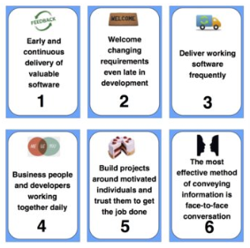
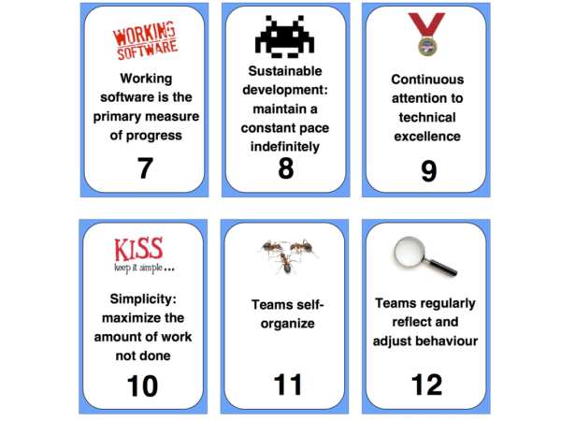
Agile Principles
Notes:
Let's just revisit our agile principles.
Creating our requirements as user stories backs up some of our agile principles. Can you spot which ones and identify why?
Concept
Why do we express needs as user stories
Relates back to Agile Principles
[Recap Agile Principles]
Concrete
?in pairs? Please look at this list and write down which ones connect to value / user / goal (not every thing does)
Talk back to group.
Some do not connect to these three things. However, they do link to the method of developing user stories especially WHO / WHEN / HOW
In pairs again – work out which principles lie behind the practise of developing user stories
Talk back to group
Conclusion:
While there are many ways to write user requirements this method works together with our agile principles and puts our users and their needs at the forefront of our mind.

Slide 21
Acceptance Criteria
Build right thing
Build thing right
AIM
Notes:
Acceptance criteria
Every user story should have at least one acceptance criteria.
Acceptance criteria show us what is expected of the ticket – if all of the criteria are met then we accept the user story and it can be released/Acceptance criteria define the boundaries of a user story, and are used to confirm when a story is completed and working as intended.
What not how.
Given when then is one way to write ACs – this gives us a structure to help us think about he scenarios.
Objective: Knows what acceptance criteria are. Can write ACs
Connect: In your groups think about your apprenticeship. When you started your apprenticeship what were the things that would you what done looked like? How did you know what was expected of you?
- coaches to help groups. Given a syllabus in advance outlining the course content and all of the elements expected of them. Included pass marks.
Concept: Acceptance criteria help us build the thing right. Combined with our user stories (focused on building right thing). ACs help us to define what’s expected of the product. Have a clear pass or fail. Could explain expected performance, functionality etc.
Concrete Practice: Write some Acs for one or more stories we’ve created.
Conclusion:

Slide 22

User Story Splitting
Independent
Negotiable
Valuable
Estimable
Small
Testable
Notes:
As we’ve said our User Story Mapping gave us an idea of the scope of our project and we broke the work down into some big chunky goals and an idea of which user would want to perform each goal.
That still leaves us with some big chunks of work that we need to make smaller. Let's bring to life why we want to work on smaller chunks of work
Let's bring this to life:
<Dots estimating exercise here>
Concept
It is hard to estimate big complex stuff. We need to break it down.
Smaller work is more predictable, more manageable, reduces risk, reduces variables.
We should aim for every story to be INVEST. INVEST provides us with a checklist of principles we can check each story against to validate it
- explain why each is important
- INDEPENDENT – the team should be able to do all of the work themselves – it shouldn't depend on another story to be delivered – this allows us to truly prioritise in terms of importance. It definitely shouldn't depend on team or person outside of the team to do anything in order to complete the story.
- NEGOTIABLE – the story should roughly capture what is needed and the team collaborate and negotiate with the customer (or Product Owner acting on customer behalf)and dev team. The goal is to meet customer needs
VALUABLE – if we cannot identify the value to the user then we should not have a story. The structure we will show you for user stories helps us identify what the value is.
ESTIMABLE – we should be able to estimate the size of the story and the value it will deliver – these may both more relative ("this story delivers more value than this one, this story is larger than that one")
SMALL – As we saw in the previous exercise small should decrease complexity and will help us deliver a little bit to the customer and get feedback about whether it WAS valuable.
TESTABLE - Every story needs to be testable in order to be “done.” Having an eye on testing at story creation point builds in quality from the off – we start thinking about what good looks like from the start and can include it through the build process. We also make sure that we know HOW and WHERE we will test the story and that testing can be done within the current sprint.

Slide 23
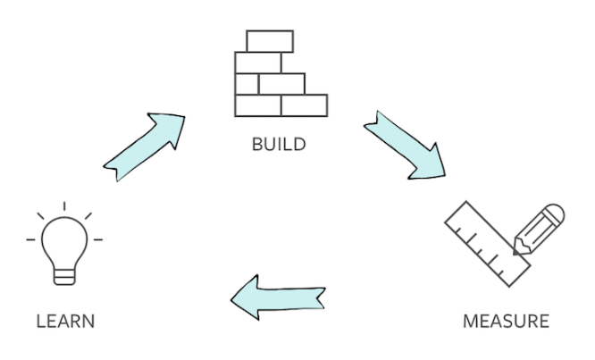
Hypothesis Driven Design
Notes:
We talked yesterday about different ways from User stories.
We’ll do a whistle stop tour of Hypotheses.
Typically would use a hypothesis when we know what result we want but we’re not sure how to get there.
We can experiment with the what and how using hypotheses to hit our goal. This allows us to follow a classic build, measure, learn model.
We set our hypothesis, we build something we think might satisfy the hypothesis, we measure the impact it had and we learn. We might learn that this feature is a major turn off to customers in which case we could try something different. We might learn that they love it and we should do more.
Hypotheses are really useful when you’re looking to optimising your product.
Format:
WE BELIEVE THAT <doing x>
WILL RESULT IN <this outcome>
WE KNOW WE HAVE BEEN SUCCESSFUL WHEN <we see a change in metric x>
e.g. We believe that enabling video conferencing functionality to staff will result in less staff travel. We will know we have been successful when we see flights taken by staff, for face to face meetings, have reduced by 5%.
POINT TEAM AT FURTHER READING AS HAVE ONLY SCRATCHED SURFACE

Slide 24

USER STORY CLINIC
Notes:
Work with the team to clinic some real world user stories.

Slide 26
HANDOUTS

Slide 27
User Story Mapping
Collaborative scoping tool
Visual
USER
ACTION
VALUE

Slide 28
What is a user story?
Ideas, feedback, data
Articulates a need from the perspective of one particular type of user
Helps us capture requirements
Conversation starter
Collaboration Tool
A comprehensive specification
Jira/Mingle/Trello tickets
Team
User Stories

Slide 29
Why User Stories?
As a commuter
I want to be be able to make a donation to someone on the street
So that I feel like I am helping them get a bed for the night.
User Focused
Value focused
Help prioritise
Get value sooner
Make working increments of software a key focus

Slide 30
User Story Splitting
Independent
Negotiable
Valuable
Estimable
Small
Testable

Slide 31
Further Reading
Pareto's Law
Maslow’s hierarchy of needs
User Story Mapping
https://www.jpattonassociates.com/the-new-backlog/
https://www.thoughtworks.com/insights/blog/story-mapping-visual-way-building-product-backlog
Agile Manifesto (values and principles)
https://agilemanifesto.org/
User Stories
https://ronjeffries.com/xprog/articles/expcardconversationconfirmation/
User Story Splitting
https://agileforall.com/resources/how-to-split-a-user-story/

